Slide 1
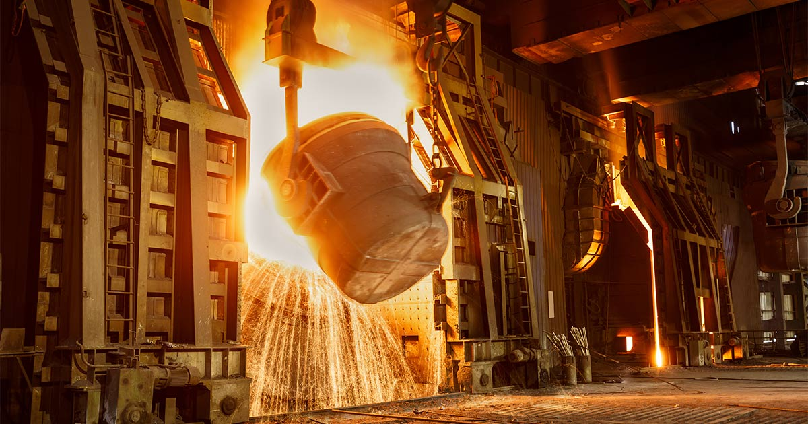
INVESTMENT OPPORTUNITY IN INDIA’S GROWING STEEL INDUSTRY
FEBRUARY 2025

Slide 2
Global Iron/Steel Industry Overview
Global steel market size was USD 1,823.5 billion (US$1.82 Tn) in 2022 and is anticipated to grow at 4 4% CAGR and reach USD 2,901.9 billion (US$ 2.9 Tn) by 2033
The growth is likely to be propelled by Increasing construction and infrastructure projects globally, growing demand for lightweight, cost-effective and strong materials in shipbuilding, aerospace, consumer electronics, and other industries etc
Globally ~52% of steel is used in Building & Infrastructure sectors followed by Mechanical Equipment (16%), Automobile (12%), Metal Products (10%) etc
Steel is made from iron ore, a compound of iron, oxygen & other minerals that occurs in nature which are found in various parts of the world with significant reserves located in Australia, China, Brazil, Russia, India etc.
Global Iron Ore production is ~2 5 MMT and Australia produces ~35% of global production followed by Brazil, China and India
China is the largest consumer of Iron Ore which translates to be world’s largest steel producing country (54 % of global steel production) followed by India (7 5%)
Globally 1,892 MMT of steel was produced in 2023 of which 71% steel was produced using Oxygen based/Blast Furnace and 29% steel was produced by Electric Arc Furnace
Source: USGS 2024

Slide 3
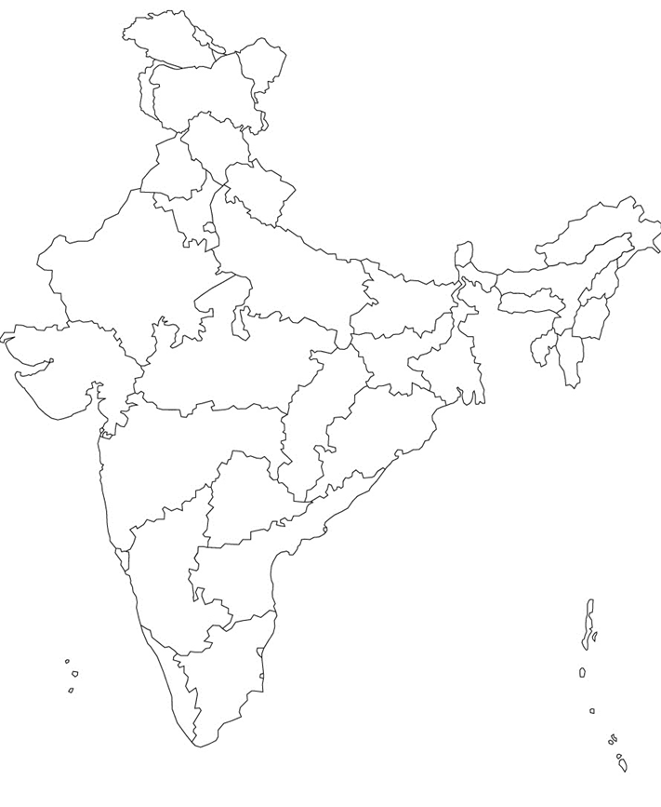
Indian Steel Industry Overview
India’s Iron Ore Resources
Indian Steel Industry Market size by value was estimated at USD 187.2 billion in 2023 and is expected to grow at a CAGR of 9 3% reaching to USD 285.2 billion by 2030 (Source BlueWeave Consulting)
Indian steel sector is the backbone of the country and plays a significant role in India’s economic growth by contributing ~ 2% of India’s GDP
Rapid infrastructure development projects, urbanization and industrialization, thriving automotive industry are some expected to drive India Steel Market during the forecast period between 2024 and 2030
History of India’s modern steel industry dates back to the 19th century with Tata Iron and Steel Company establishing plant in 1907
India has 35286 MMT of Iron Ore reserves which are largely located in Karnataka (30%), Odisha (26%), Chhattisgarh (13%) and Jharkhand (13%)
India is the world’s second-largest producer of crude steel, with an output of 125.32 MT of crude steel and finished steel production of 121.29 MT in FY23
In FY24, the production of crude steel and finished steel stood at 143.6 MT and 138.5 MT, respectively
Jharkhand 13%
Chhattisgarh 13%
Odisha 26%
Karnataka 30%
Total Resources: 35,286 MMT
Source: Indian Minerals Yearbook 2021 (Part III), 60th Edition, Iron Ore (Advance Release), dated May 2023

Slide 4
Indian Steel Sector Overview
India is the second-largest steel producer in the world with an installed capacity of 161 3 MT in FY23 and consumption of 126 MT in FY2023
The domestic crude steel production has grown at a CAGR of 3 3% in the past five years to reach 126.3 MT in FY23 from 110.9 MT in FY19 and this growth is due to increased domestic demand, availability of raw materials, cost effective labor etc.
Large steel manufacturers’ capacity utilization has been in the range of 80-90% in FY23 and most players have announced the expansion of crude steel capacities
The National Steel Policy 2017 envisages achieving 300 MT of production capacity from the current level of 153-157 MT to cater to expected steel demand of 230 MT by FY31
India’s eastern region, well-endowed with mineral resources, enjoys the largest share in the total crude steel-making capacity (55%) and is led by Odisha having more than 30 MMT crude steel capacities
Odisha is rich in iron ore reserves having more than 26% reserves and abundant ancillary factors such as coal, water etc making Odisha preferred location for steel production
Source: (26) Infograph: India's crude steel capacities by states in 2023 | LinkedIn

Slide 5
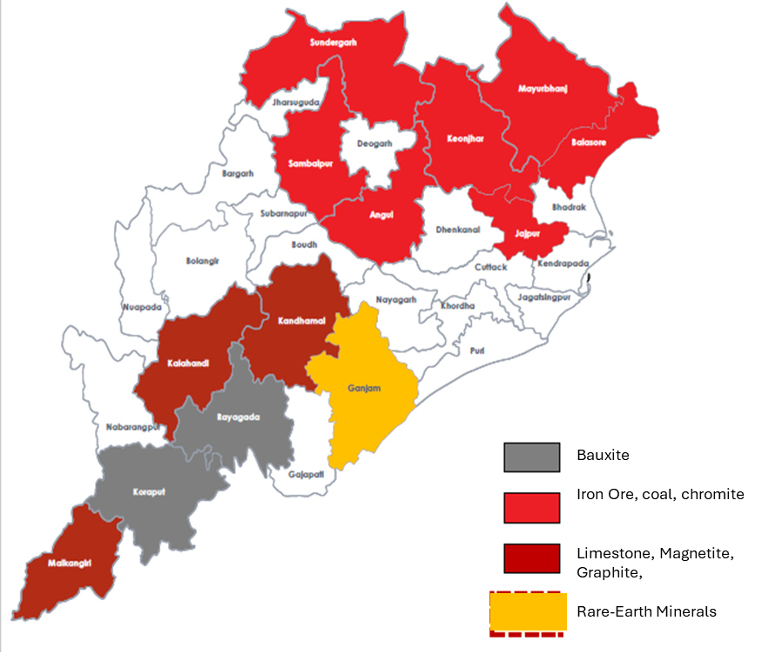
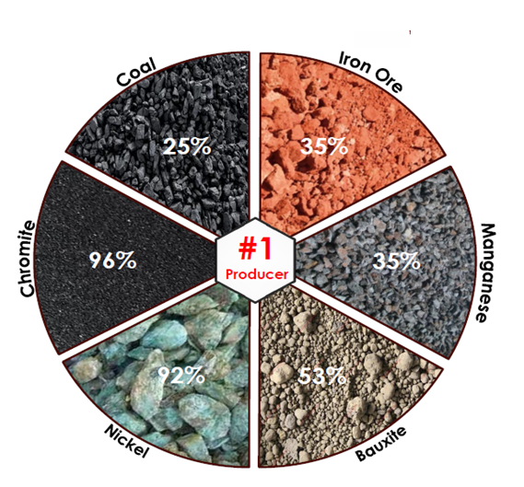
Odisha Steel Sector Overview
Odisha’s Mineral
Map
Odisha is ranked #1 among all states, contributing to 41.9 % (Rs 38,075 Crore) in 2022-23 by value of all Minerals in India with the top contributors including Chromite (96%), Nickel (92%), Bauxite (53%) with Manganese & Iron Ore each having 35% share
The state of Odisha is India's largest DRI producer, with ~15 MMTPa (FY 23) accounting for 24% of the total production
Odisha has 52 operational steel plants with installed capacity of around 34 MMTPA as of 2022-23 State has Targeted to achieve > 130 MTPA by 2030
Odisha has signed 49 MoUs with National & International steel companies for establishment of new steel plants apart from Rourkela of SAIL, Kalinga Nagar of NINL and MESCO
The state is strategically located as a gateway to ASEAN region having access to 50% of World Economy in a span of 6 hours
For Ease of doing business, Odisha has numerous facilities:
Capital Investment Subsidy of 20% with no Upper Cap Limit
100% Reimbursement of Net SGST paid (limited to 200%)
3 Major export & import ports
5 Airports
100% reimbursement of ESI / EPF upto 7 Years

Slide 6
Odisha Iron Ore/Chromite Ore Reserves
MINERAL | DISTRIBUTION | LOCATION | GEOLOGY | RESERVES
Iron Ore | Kendujhar District | Roida-Bhadrasahi, Unchabali, Jajang, Jurudi, Belkundi, Bolani, Khandbandh, Katamati, Thakurani, Gandhamardan, Joda-East, Haromoto, Guali, Kasia, Malangtoli etc. | Iron ore bands occur in layered BIF along with volcanosedimentary rock piles known as Iron Ore Super Group | 5,153 million tonnes
 | Sundargada District | Barsuan,Taldihi, Kalta, Khajuridihi, Ganua, Koira, Kurmitarpahar, Rantha, Mankarnacha, , Badamgarh pahar, Baliapahar MithihurdaBasada etc
 | Mayurbhanj District | Suleipat, Ghusura, Gorumahisani, Badampahar, etc
 | Jajpur District | Daitari-Tomka
Chromite | Jajpur District | Sukinda Ultramafic complex | Occur as intrusive into Precambrian metamorphites as well as differentiated layered igneous complexes | 173.80 million tonnes of all categories with 40 to 45% Cr2 O3
 | Kendujhar District | Boula-Nuasahi Igneous complex
 | Baleswar District | Bhalukasuni
https://www.odishaminerals.gov.in/Download/geology_mineral_resources_orissa.pdf

Slide 7
Odisha: Steel Industry
Major Steel Clusters of Odisha
Sr No | Cluster | No of Plants
1 | Angul | 2
2 | Cuttack | 5
3 | Dhenkanal | 6
4 | Jajpur | 1
5 | Ganjam | 1
6 | Jagatsinghpur | 1
7 | Jharsuguda | 7
8 | Keonjhar | 8
9 | Sambalpur | 5
10 | Sundargarh | 5
11 | Jajpur | 4
 | Total* | 45
Department of Steel and Mines, Government of Odisha
Production Scenario of Steel, Sponge Iron & Pellets (MMTPA)
Production | Approved Capacity | Installed Capacity | FY 19 | FY 20 | FY 21 | FY 22 | FY 23
Steel by MOU Plants | 134 | 25 27 | 14 04 | 15 03 | 16 10 | 18 73 | 19 74
Steel by Non MOU Plants | 51 | 7 86 | 5 23 | 4 62 | 4 40 | 4 99 | 5 39
Steel | 185 | 33 13 | 19 27 | 19 65 | 20 50 | 23 72 | 25 12
Sponge Iron | - | 15 29* | 6 82 | 7 67 | 7 87 | 9 74 | 10 96
Pellet | 45 30 | 35 80 | 19 89 | 22 34 | 22 87 | 25 77 | 28 07
*Rest plant’s location is scattered across districts
Odisha holds No 1 position in the production of Steel and Stainless Steel in India and has produced 25.12 million tons of Crude Steel in 2022-23
Odisha produced more than 60% of the total Iron ore produced in the country in 2022-23
viewdocument ashx

Slide 8
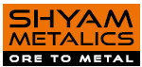
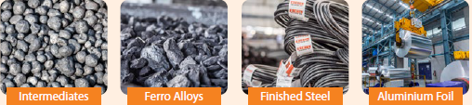
Success Story: Shyam Metaliks
Kolkata based Shyam Metaliks, established in 1991 is chaired by Mr. Mahabir Prasad Agarwal operates integrated steel plants with total capacities exceeding 13 MMTA and is the 6th Largest metal producing company in India
Shyam Metaliks has seven strategically located facilities in West Bengal, Odisha, Jharkhand and Madhya Pradesh exporting to 28 Countries contributing to 10% of overall revenue share in FY 24.
The company has diversified product lines such as iron ore pellets, sponge iron, ms billets, TMT, structure & wire rods, captive power plant, ferro alloys and aluminum foil
The company has expansion plan in the tune of 4,575 crores focusing on stainless-steel manufacturing facilities, power generation, iron production and specialty products
Around ~ 78% of power requirements is met through its captive power plants with renewable sources contributing 0.04% of total energy requirements
The company has acquired Mittal Corp limited in 2016 at a valuation of 351 crores through successful corporate insolvency resolution process (CIRP) approved by NCLT
Financials
(INR Cr) | FY2021 | FY2022 | FY2023 | FY2024
Revenue | 6297 | 10393 | 12658 | 13195
EBITDA | 1394 | 2600 | 1499 | 1570
EBITDA (%) | 22 | 25 | 12 | 12
PAT (%) | 13 | 17 | 7 | 8
Networth | 3249 | 5470 | 6227 | 8623
Debt :Eq Ratio | 0 21 | 0 09 | 0 13 | 0 06
SMEL-Annual-Report-2023-24
Product Portfolio
Notes:
No Fullstops, commas
Continuous statements, Put Numbers in Brackets (), Formatting colour must be uniform

Slide 9
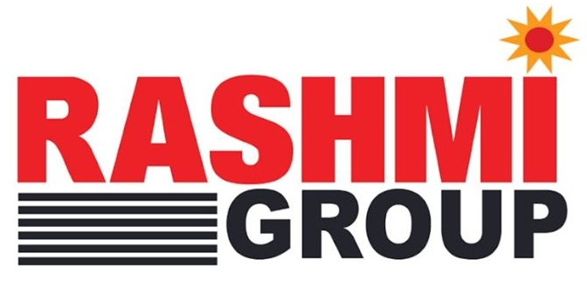
Success Story: Rashmi Metaliks Ltd (RML)
Financials
Kolkata based Rashmi group, established in 1991, by Mr. Sajjan Kumar Patwari and his family members; RML was incorporated in 2004 to increase spread in the steel industry with manufacturing units located in Kharagpur & Jaluria, West Bengal, India
The group is one of the largest players in the secondary steel segment with total capacities exceeding 26 million tonnes as on additionally, 2023 across different product lines such as iron ore pellets, pig iron, sponge iron to finished steel products like TMT and Di (ductile iron) pipes
The promoters has vast experience of over four decades in the steel industry and have established forward & backward integrated operations with the company operating two railway sidings at Barbil, Odisha and Gokulpur, West Bengal, to facilitate movement of raw materials and finished goods
For meeting its power requirements, the group has captive power plant (300MW) and a waste-heat recovery boiler to generate power for captive consumption
Additionally, a coal mine block – Jagannathpur, Durgapur, West Bengal, has been alloted to the group, which lowers the RM & Power cost; among other sister companies, Reach Infocom specializes in technical products like PC’s & Laptops
(INR Cr) | FY2022 | FY2023
Op. Income | 14885 | 21006
EBITDA | 3285 | 5000
PAT | 2182 | 2712
PAT (%) | 14.7 | 12.9
Debt / Networth (%) | 0.01 | 0.14
Expansion Plan
RashmiMetaliksLimited CRISIL Ratins
Category | FY 2022 | FY 2025
Iron & Steel (MTPA) | 3.00 | 5.0
Cement (MTPA) | 1.00 | 2.00
Power (MTPA) | 348 | 600
Pellet (MTPA) | 9.00 | 11.00
Turnover (INR Cr) | 24800 | 35000
Investment (INR Cr) | 8000 | 12500
Net worth (INR Cr) | 13300 | 16000
https://www.rashmigroup.com/

Slide 10
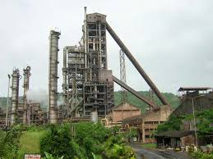
Investment Opportunity: Vikram Private Limited
Vikram Private Limited (VPL) promoted by Mr. R K Jena and Mrs. Suman Sarita Jena, was incorporated on 13th March’2000
Odisha based VPL manufactures and sales sponge iron (DRI) with an installed capacity of 60,000 (2 X 100 TPD) metric tons per annum
VPL procure iron ore from mines located within 25-30 kms distance, which results in higher margins due to minimal logistic costs
VPL has marquee clients such as Galwalia Ispat Udyog, Kashi Viswanth Steel, Shree Sidhbali Steel with whom it has long standing relationship
The Company is setting up a Palletization Plant of 0.6 MTPA with beneficiations plant of 0.85 MTPA adjacent to the existing unit, along with some modification to the existing DRI Plant to feed the pellet as raw material.
The required land, water and environmental clearance from Central & State Government for the new beneficiation with palletization plant is available with the company.
Expansion Investment rationale (Total Investment ~ Rs 9 Crore)
(INR Cr) | FY2025 | FY2026 | FY2027 | FY2028 | FY2029 | FY2030
Revenue | 126 | 168 | 168 | 168 | 168 | 168
EBITDA | 25 | 34 | 34 | 34 | 34 | 34
EBITDA (%) | 20 | 20 | 20 | 20 | 20 | 20
VPL Plant, Tumkela, Sundargarh, Odisha

Slide 11

Project Description – Iron-Steel & Power
Sundargarh, Odisha
Phase – 1 (Total Investment ~ Rs 450 Crore)
Phase – 2 (Total Investment ~ Rs 1332 Crore)
Parameters | Production Capacity | Investment (INR Cr)
Iron ore Beneficiation Plant : 0.85 MTPA Input | 6,00,000 (TPA) | 299
Iron Ore Pellet Plant : 0.6 MTPA Output
Captive Power Plant : WHRB (4 MW) & AFBC (6MW) | 71 Million Units (10 MW) | 65
Steel Melting Shop : 3 x 12 T IF with CCM & LRF | 1,20,000 (TPA) | 41
Rolling Mill-1 | 1,00,000 (TPA) | 45
Parameters | Production Capacity | Investment (INR Cr)
DRI Plant : 1 x 350 TPD | 1,15,500 (TPA) | 120
DRI Plant : 3 x 350 TPD | 3,46,500 (TPA) | 324
Captive Power Plant: WHRB (35 MW) , AFBC (10 MW), CFBC ( 30 MW) | 535 Million Units, (75 MW) | 488
Steel Melting Shop : 8 x 20 T IF with CCM, AOD, VDG & LRF | 5,28,000 (TPA) | 200
Rolling Mill-2 | 5,12,160 (TPA) | 200
Financials
Financials
(INR Cr) | FY2026 | FY2027 | FY2028 | FY2029 | FY2030
Revenue | 469 | 1039 | 1039 | 1039 | 1039
EBITDA | 113 | 228 | 228 | 228 | 228
EBITDA (%) | 24% | 22% | 22% | 22% | 22%
(INR Cr) | FY2026 | FY2027 | FY2028 | FY2029 | FY2030
Revenue | - | 2,561 | 2,561 | 2,561 | 2,561
EBITDA | - | 563 | 563 | 563 | 563
EBITDA (%) | - | 22% | 22% | 22% | 22%
Notes:
10 MW = (10*0.9*24*330*1000/ 10^6) Million Units

Slide 12



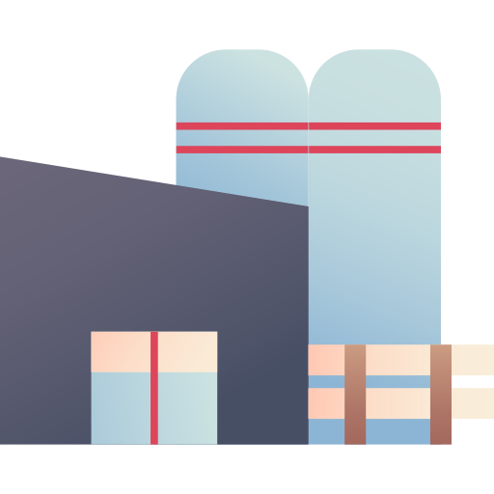

Thank You
Alupur, Near Laxminarayan Temple, O T Road, Balasore 756001
Plot No 347-358, Gadabhanga, Khantapada, Balasore 756043
info@highlandgroups com
Notes:
World-Steel-in-Figures-2024.pdf

Slide 13
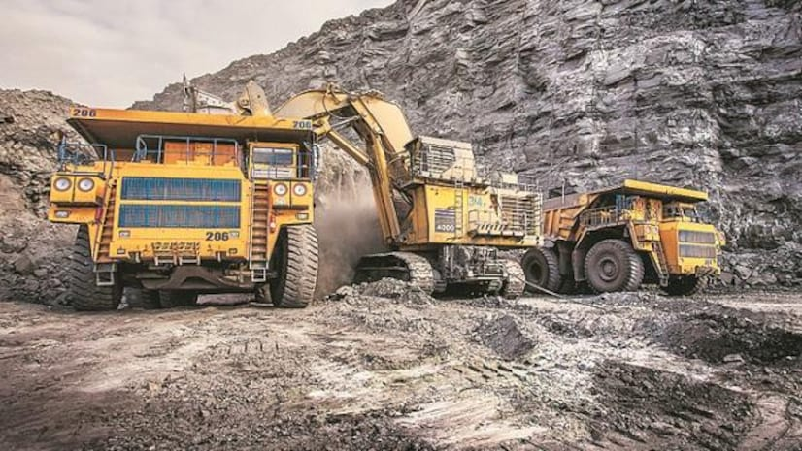
INVESTMENT OPPORTUNITY IN MANGANESE- IRON ORE MINE and
FERRO-ALLOY PLANT
FEBRUARY 2025

Slide 14
Project Description – Acquisition of Mn-Fe Ore Mines & Ferro-Alloy Plant
Haldia Port, WB
Phase – 1 (Total Investment ~ Rs 1400 Crore)
Financials
Parameters | Production Capacity | Investment (INR Cr)
Submerged Electric Arc Furnace (2 X 5 MVA, 9 X 9 MVA) | 1,44,144 (TPA) | 270
Capacity of Mn-Ore | 1,90,000 (TPA) | 1130
Capacity of Fe-Ore | 1,40,000 (TPA)
(INR Cr) | FY 2026 | FY2027 | FY2028 | FY2029 | FY2030
Revenue | 1,009 | 1,009 | 1,009 | 1,009 | 1,009
EBITDA | 111 | 111 | 111 | 111 | 111
EBITDA (%) | 11% | 11% | 11% | 11% | 11%
Advantages
Ferro Alloys (Fe-Mn), are essential ingredients that are added in normal and special steel production for de-oxidation, grain size control and also enabling finished steel to have certain properties which are specific to the type and grade. Ferro Alloys also play a role in improving and enhancing the mechanical properties of the steel

Slide 15
Project Description – Acquisition of Mn-Fe Ore Mines & Ferro-Alloy Plant
Haldia Port, WB
Phase – 2 (Total Investment ~ Rs 1712 Crore)
Financials
Parameters | Production Capacity | Investment (INR Cr)
Capacity Enhancement Mn-Ore | 5,00,000 (TPA) | 50
Capacity Enhancement Fe-Ore | 5,00,000 (TPA) | 50
Submerged Electric Arc Furnace : 3 x 12 MVA | 57,024 (TPA) | 108
DRI Plant : 1 x 900 TPD | 2,97,000 (TPA) | 308
Iron ore Beneficiation Plant : 1 MTPA Input | 8,50,000 (TPA) | 350
Iron Ore Pellet Plant : 0.85 MTPA Output
Captive Power Plant: WHRB (25 MW) & AFBC (10 MW) | 321 Million Units (35 MW) | 228
Thermal Power Plant : 95 MW | 677 Million Units (95 MW) | 618
(INR Cr) | FY 2026 | FY2027 | FY2028 | FY2029 | FY2030
Revenue | - | 399 | 1,514 | 1,514 | 1,514
EBITDA | - | 44 | 237 | 237 | 237
EBITDA (%) | - | 11% | 16% | 16% | 16%

Slide 16
Thank You
Alupur, Near Laxminarayan Temple, O T Road, Balasore 756001
Plot No 347-358, Gadabhanga, Khantapada, Balasore 756043
info@highlandgroups com
Notes:
World-Steel-in-Figures-2024.pdf

Slide 17
Project Description – Acquisition of Mn-Fe Ore Mines & Ferro-Alloy Plant
Haldia Port, WB
Phase – 2 (Total Investment ~ Rs 1712 Crore)
Financials
Parameters | Production Capacity | Investment (INR Cr)
Capacity Enhancement Mn-Ore | 5,00,000 (TPA) | 50
Capacity Enhancement Fe-Ore | 5,00,000 (TPA) | 50
Submerged Electric Arc Furnace : 3 x 12 MVA | 57,024 (TPA) | 108
DRI Plant : 1 x 900 TPD | 2,97,000 (TPA) | 308
Iron ore Beneficiation Plant : 1 MTPA Input | 8,50,000 (TPA) | 350
Iron Ore Pellet Plant : 0.85 MTPA Output
Captive Power Plant: WHRB (25 MW) & AFBC (10 MW) | 321 Million Units (35 MW) | 228
Thermal Power Plant : 95 MW | 677 Million Units (95 MW) | 618
(INR Cr) | FY 2026 | FY2027 | FY2028 | FY2029 | FY2030
Revenue | - | 399 | 1,514 | 1,514 | 1,514
EBITDA | - | 44 | 237 | 237 | 237
EBITDA (%) | - | 11% | 16% | 16% | 16%
Executive Summary
TOTAL INVESTMENT: ₹ 4894 Crore
TOTAL REVENUE / ANNUM: ₹ 6291 Crore
TOTAL EBIDTA / ANNUM : ₹ 1174 Crore

Slide 18
List of References used :
OES Chapter_1(Main Booklet)_0.pdf
BigMint (formerly SteelMint/CoalMint)
World-Steel-in-Figures-2024.pdf
Department of Steel and Mines, Government of Odisha
Industrial-policy-resolution-2022
SMEL-Annual-Report-2023-24
Blue Wave Consulting Steel Report
National Steel Policy

Slide 19
Mines
Haldia & Bishnupur, WB
Our acquisition of the existing Mines will reduce our Raw Material price by min Rs 500 / Unit
Ferro Alloys (Fe-Mn), are essential ingredients that are added in steel production for de-oxidation, grain size control and also enabling finished steel to have certain properties which are specific to the type and grade Ferro Alloys also play a role in improving and enhancing the mechanical properties of the steel
Parameters | 1st Phase | Improvement | 2nd Phase
Capacity | 84,000 TPA 2 X 5 MVA 7 X 9 MVA | Prod Capacity Enhance to 120000 TPA | 50 MW Solar Plant
Production | 1 9 Lakh TPA – Mn Ore 1 4 Lakh TPA – Fe Ore | Clearance for Mining 5 Lakh TPA – Mn & Fe Ore | Beneficiation for Dump Ore of Mn
ASP (Rs / Ton) | ₹ 13,000 – Mn Ore ₹ 6,000 - Fe Ore | Chemical Grade Mn/Fe Ore = 2000 Tons | 6 Lakh TPA DRI Plant @ Haldia for Export
Annual Revenue (Crore) | ₹ 247 – Mn Ore ₹ 84 – Fe Ore
Margin / Ton | ₹ 7000 – Mn Ore ₹ 3000 - Fe Ore

Slide 20
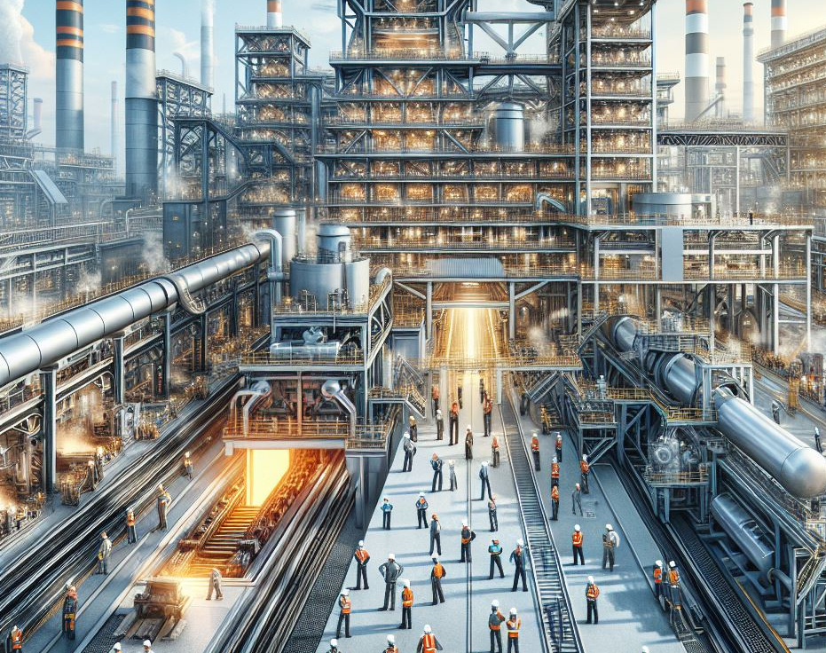
VIKRAM STEEL

Slide 21
Investment Opportunity: Vikram Private Limited
Vikram Private Limited (VPL) promoted by Mr R K Jena and Mrs Suman Sarita Jena, was incorporated on 13th March’2000
Odisha based VPL manufactures and sales sponge iron (DRI) with an installed capacity of 66,000 metric tons per annum
VPL procure iron ore from mines located within 25-30 kms distance, which results in higher margins due to minimal logistic costs
VPL has marquee clients such as Galwalia Ispat Udyog, Kashi Viswanth Steel, Shree Sidhbali Steel with whom it has long standing relationship
The Company now proposes for setting up a Pelletization Plant of 0 6 MTPA with beneficiations plant of 0 85 MTPA adjacent to the existing unit, along with some modification to the existing DRI Plant to feed the pellet as raw material
furthermore,a Fe-Mn Mine acquisition proposal is under consideration, which will significantly reduce the raw material cost with the estimated combined project cost being approximately INR 2000cr
The required land for the new beneficiation with palletization plant is available with the company and the mine acquisition due diligence is on the verge of completion.
Investment rationale
(INR Cr) | FY2023 | FY2024 | FY2025E | FY2026P
Revenue | 153 | 179 | 200 | 250
EBITDA | 22 | 28 | 35 | 50
EBITDA (%) | 14 | 16 | 18 | 20
PAT (%) | 10
Networth
Total Debt
Vikram Steel Plant at Sundargarh, Odisha

Slide 22
Expansion Plan
About Existing Plant
Product Type : Spong Iron
Existing Capacity of the Plant (DRI) : 60,000 TPA
Proposed Expansion
Iron Ore Beneficiation Plant : 0 85 MTPA
Pelletizing Plant : 0 60 MTPA
Steel Making Shop : 1,20,000 TPA
Rolling Mill : 1,00,000 TPA
New Sponge Iron Plant (DRI) : 4,80,000 TPA
Power Plant : 3 x 10 MWH
₹ 1000 Cr Investment plan for the proposed
New Capacity addition
Projected
ANNUAL TURNOVER [IN CR ]

Slide 23

SUCCESS STORIES

Slide 24
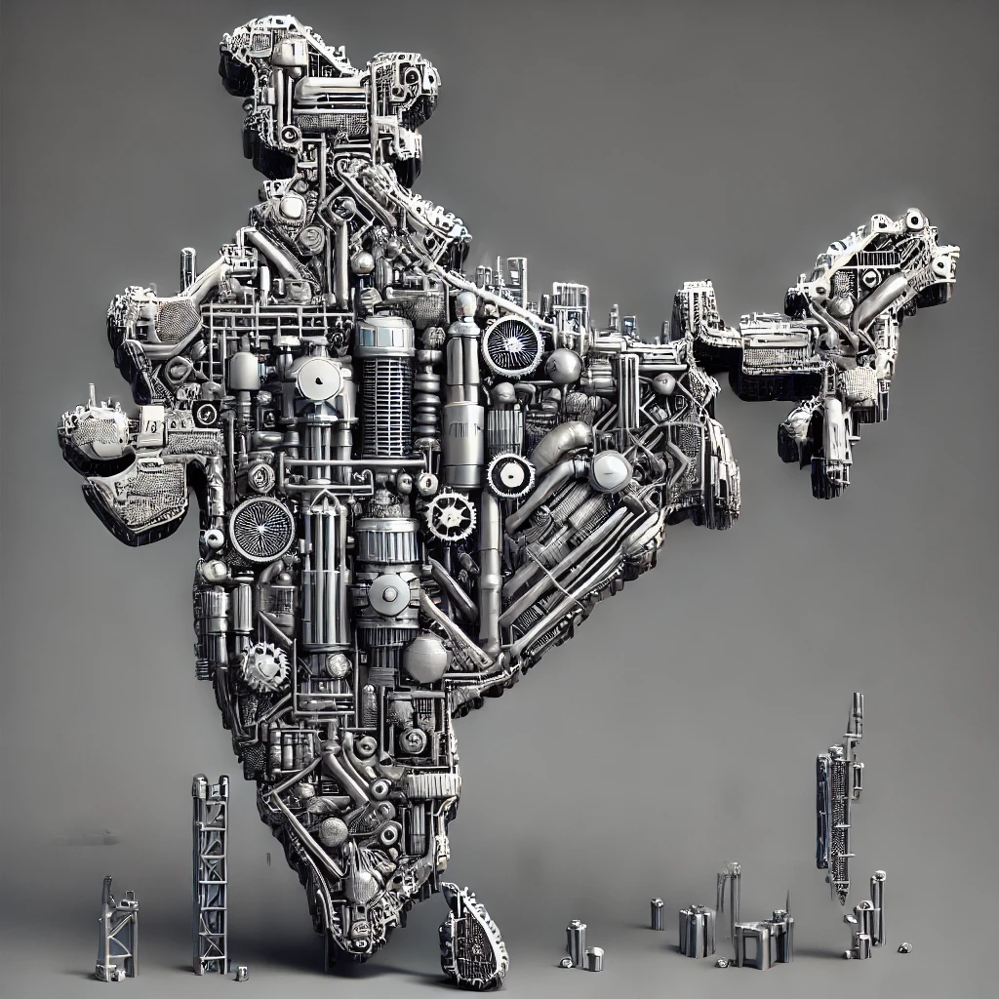

INDIAN STEEL SECTOR

Slide 25
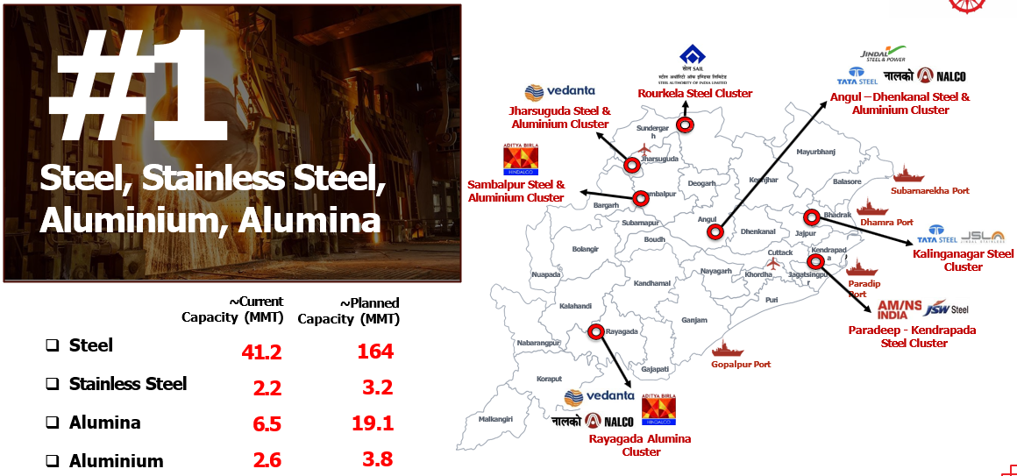
ODISHA STEEL SECTOR

Slide 26

MINES
&
MINERALS

Slide 27
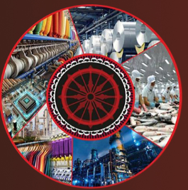

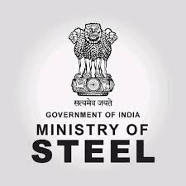


AGENDA
WORLD STEEL OVERVIEW
INDIA OUTLOOK
ODISHA SCENARIO
SUCCESS STORIES
VIKRAM STEEL
Highland Minning

Slide 28

Global Iron/Steel Overview

Slide 29
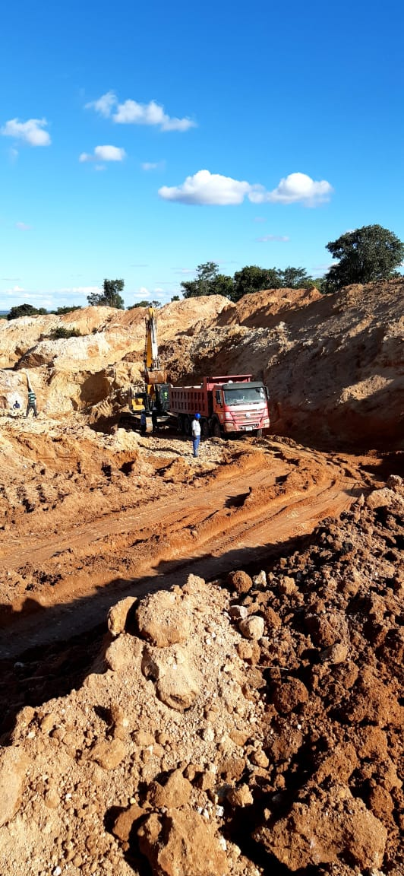
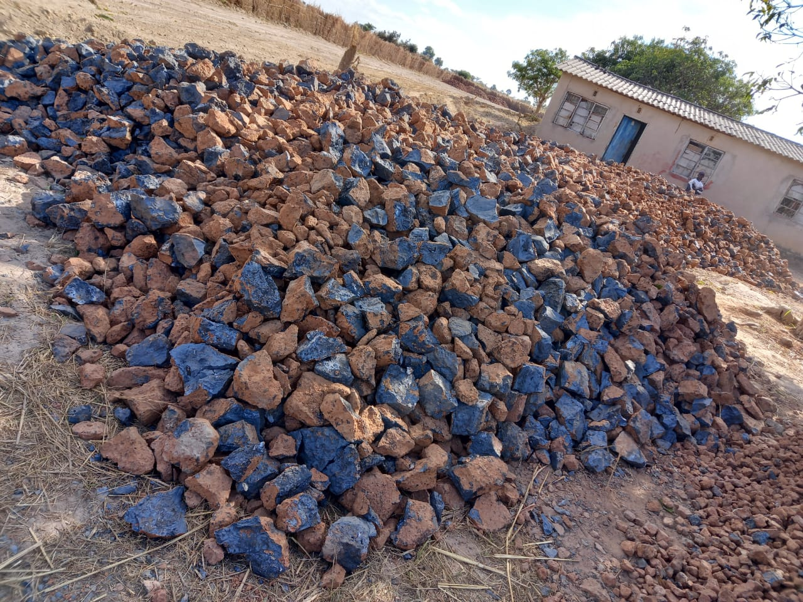
HIGHLAND MINES & MINERALS, ZAMBIA
Mines Area : 1,00,000 Hectors
Type of Mines : Manganese
Quality / Grade of Manganese : 50%+

Slide 30
Addition of new Iron & Manganese Mine
SILJORA-KALIMATI (MANGANESE & IRON MINE) | Area > 700 Ha
LEASE PERIOD UPTO | 2070
CAPACITY (Tons in ‘000) | Mn - 189
 | Fe - 136
PROJECT COST | ₹ 1000 Crore
MARGIN / TON | ₹ 7000 – Mn Ore
 | ₹ 3000 - Fe Ore

Slide 31
Iron & Manganese Mine PROPOSAL
Project Description | Parameters
SILJORA-KALIMATI MANGANESE & IRON MINE | Area > 700 Ha
Lease | 2070
Capacity (Tons in ‘000) | Mn - 190 Fe - 140
Project Cost | ₹ 1000 Crore
Revenue (12 K Mn & 6 K Fe / Ton)
Margin / Ton | ₹ 7000 – Mn Ore ₹ 3000 - Fe Ore
Furnace Running Status (Target of 100% running by 1st Year) | Total = 11 Operational = 8

Slide 32
Odisha Steel Sector Opportunities
Odisha has widespread presence which indicates a developed ecosystem for the steel industry across the state Out of 30 Districts, Steel industry is present in 12 districts contributing ~ 43% of Odisha’s Gross State Domestic Product (GSDP) of ₹8 3 lakh crore in FY 24 (Link)
The Northern Odisha is extremely rich in Iron-Ore Reserves and consequently houses the largest number of Steel Industries The districts of Sundergarh, Keonjhar, Jharsuguda alone constitute 90% of all Operating industries in the state
There is an opportunity for acquisition / revival of 9 Non-Operational plants located in Mineral rich region of Northern Odisha

Slide 33
Global Iron/Steel Overview
Iron Ore deposits are found in various parts of the world with significant reserves located in Australia, China, Brazil, Russia, India etc
These deposits may occur in the form of hematite, magnetite, limonite or siderite ore with different iron content properties
Global Iron Ore production is ~2 5 MMT and Australia produces ~35% of global production followed by Brazil, China and India
China is the largest consumer of Iron Ore which translates to be world’s largest steel producing country (54 % of global steel production) followed by India (7 5%)
Globally 1,892 MMT of steel was produced in 2023 of which 71% steel was produced using Oxygen based/Blast Furnace and 29% steel was produced Electric Arc Furnace
Globally ~52% of steel is used in Building & Infrastructure sectors followed by Mechanical Equipment (16%), Automobile (12%), Metal Products (10%) etc
Per capita steel consumption globally is 219 kg led by EU 310 3 kg/person and followed by Asia (295 kg)

Slide 34
Indian Steel Sector Overview
India is the second-largest steel producer in the world with an installed capacity of 161 3 MT in FY23 and consumption of 126 MT in FY2023
The domestic crude steel production has grown at a CAGR of 3 3% in the past five years to reach 126 3 MT in FY23 from 110 9 MT in FY19 and this growth is due to increased domestic demand, availability of raw materials, cost effective labour etc
Large steel manufacturers’ capacity utilization has been in the range of 80-90% in FY23 and most players have announced the expansion of crude steel capacities
The National Steel Policy 2017 envisages achieving 300 MT by 2030 of production capacity from the current level of 153-157 MT to cater to expected steel demand of 230 MT by FY31
India’s eastern region, well-endowed with mineral resources, enjoys the largest share in the total crude steel-making capacity (55%) and is led by Odisha having more than 30 MMT crude steel capacities
Odisha is rich in iron ore reserves having more than 26% reserves and abundant ancillary factors such as coal, water etc making Odisha preferred location for steel production
Source: (26) Infograph: India's crude steel capacities by states in 2023 | LinkedIn

Slide 35
Indian Steel Sector Overview
India’s Iron Ore Resources
Indian steel sector is the backbone of the country and plays a significant role in India’s economic growth by contributing ~ 2% of India’s GDP
History of India’s modern steel industry dates back to the 19th century with Tata Iron and Steel Company establishing plant in 1907
India has 35286 MnT of Iron Ore reserves which are largely located in Karnataka (30%), Odisha (26%), Chhattisgarh (13%) and Jharkhand (13%)
India is the world’s second-largest producer of crude steel, with an output of 125 32 MnT of crude steel and finished steel production of 121 29 MnT in FY23
In FY24, the production of crude steel and finished steel stood at 143 6 MnT and 138 5 MnT, respectively
The Indian Steel Association (ISA) expects steel requirement will reach 128 9 MnT in the 2023-24 period, showing an increase from 119 9 MnT in the preceding year ​
India’s domestic steel demand is estimated to grow by 9-10% in FY25 as per ICRA
Jharkhand 13%
Chhattisgarh 13%
Odisha 26%
Karnataka 30%
Total Resources: 35,286 MMT
Notes:
ICRA stands for Investment Information and Credit Rating Agency ICRA is an independent agency in India that provides credit ratings and investment information ICRA has provided credit ratings for the steel industry, including the domestic steel industry and the steel sector

Slide 36


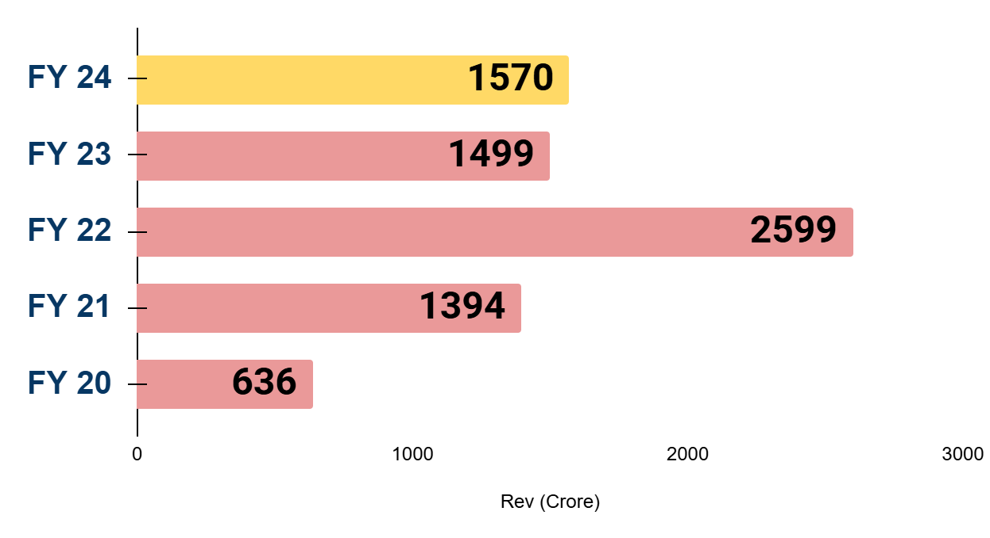
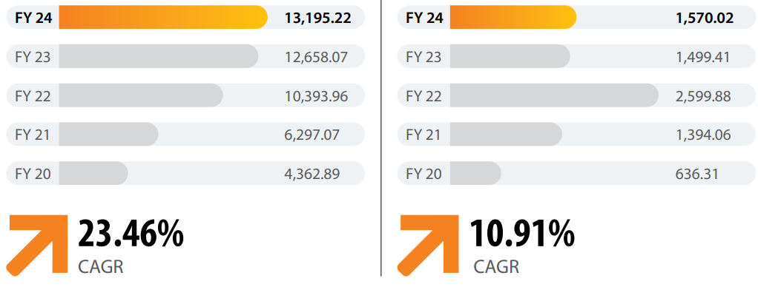
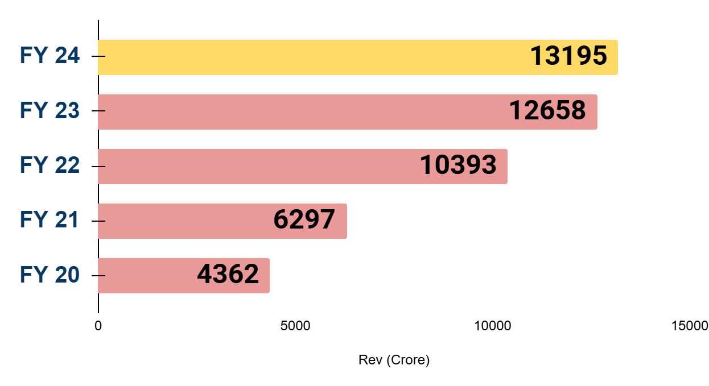
SUCCESS STORIES
Estd – 1953, Kolkata
Prod Mix - Pellets, Sponge iron, Billets, TMT bars, Ferro Alloys, Stainless Steel, Al Foils
Revenue (₹ crore)
EBITDA (₹ crore)
Estd = Capacity,
Export Countries,
Current Production Capacity
USP
Last 5 Y Financials (Revenue, EDIDTA, PAT, Total Debt, Debt-Eq Ration, Net Worth)

Slide 37
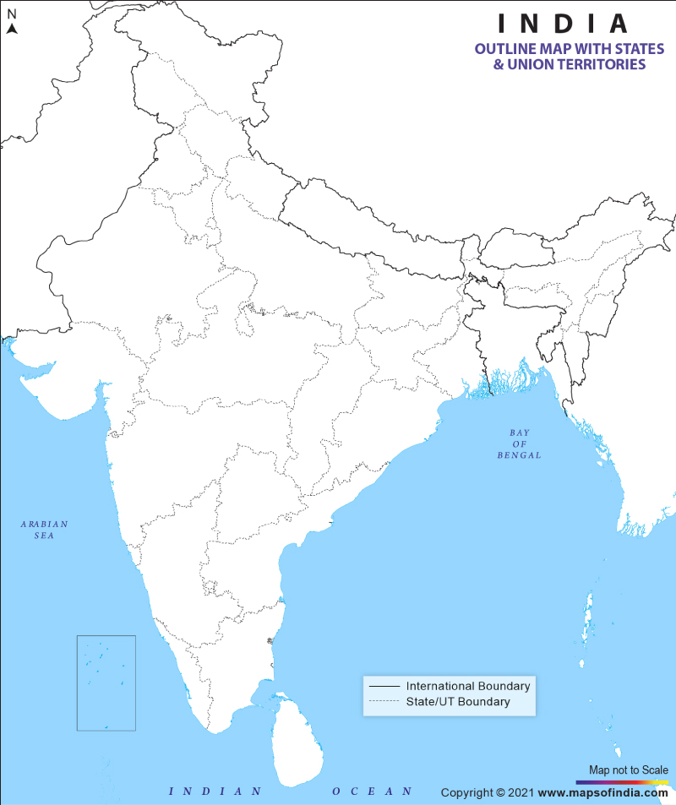

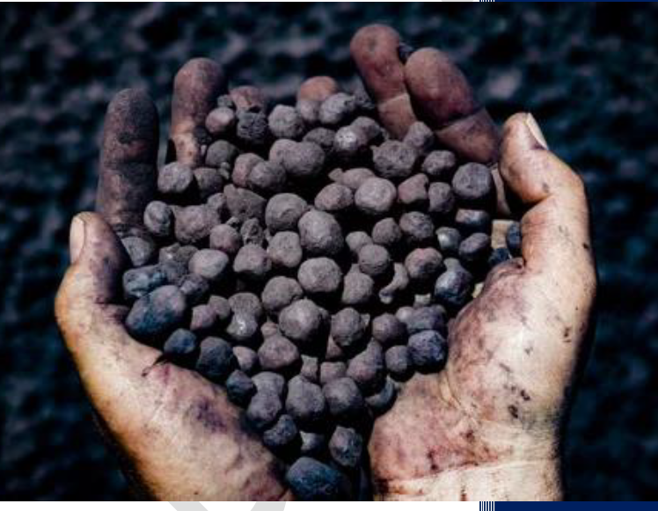



Vikram Steel
Fiscal Annual Revenue (Cr)
Installed Capacity (MT)
₹ 150
66,000
Config (TPD)
2 X 100
Capacity Utilization %
FY 22 | FY 23 | FY 24 | FY 25*
72 | 74 | 76 | 77
FG :Sponge Iron
* Projected
VENDORS
Kulda Coal Mines
CUSTOMERS
Galwalia Ispat Udyog
OMC Khandbandh
OMC Koira
B Swari
G Bahal
Kashi Viswanath Steels
Maa Sheetla Automobiles
Samridhi Traders
Shree Sidhbali Steels

Slide 38
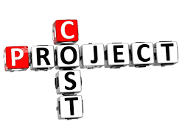
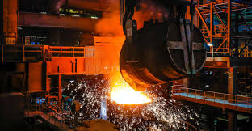
CAPACITY EXPANSION PROPOSAL
Facility | Output Details | Justification
Beneficiation Plant | 0 85 MTPA | Iron Ore Concentrate for use in Pellet Plant & Balance for sale
Pelletizing Plant | 0 60 MTPA | Iron Ore Pellets for use in DRI plant & Balance for sale
Producer Gas Unit | 3 X 7500 Nm³ | Producer Gas for Using in the Pellet Plant as fuel
PCI System | 15,000 TPA | Pulverised Coal Injection in the Pellet Plant
₹ 400 Crore
1-Jan-2026
Commercial Production
Sundargarh, Orissa

Slide 39
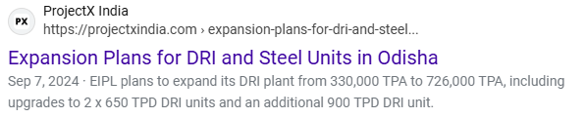
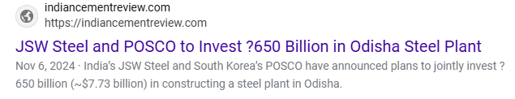
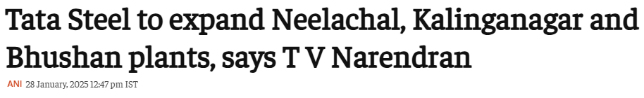
CURRENT AFFAIRS

Slide 40
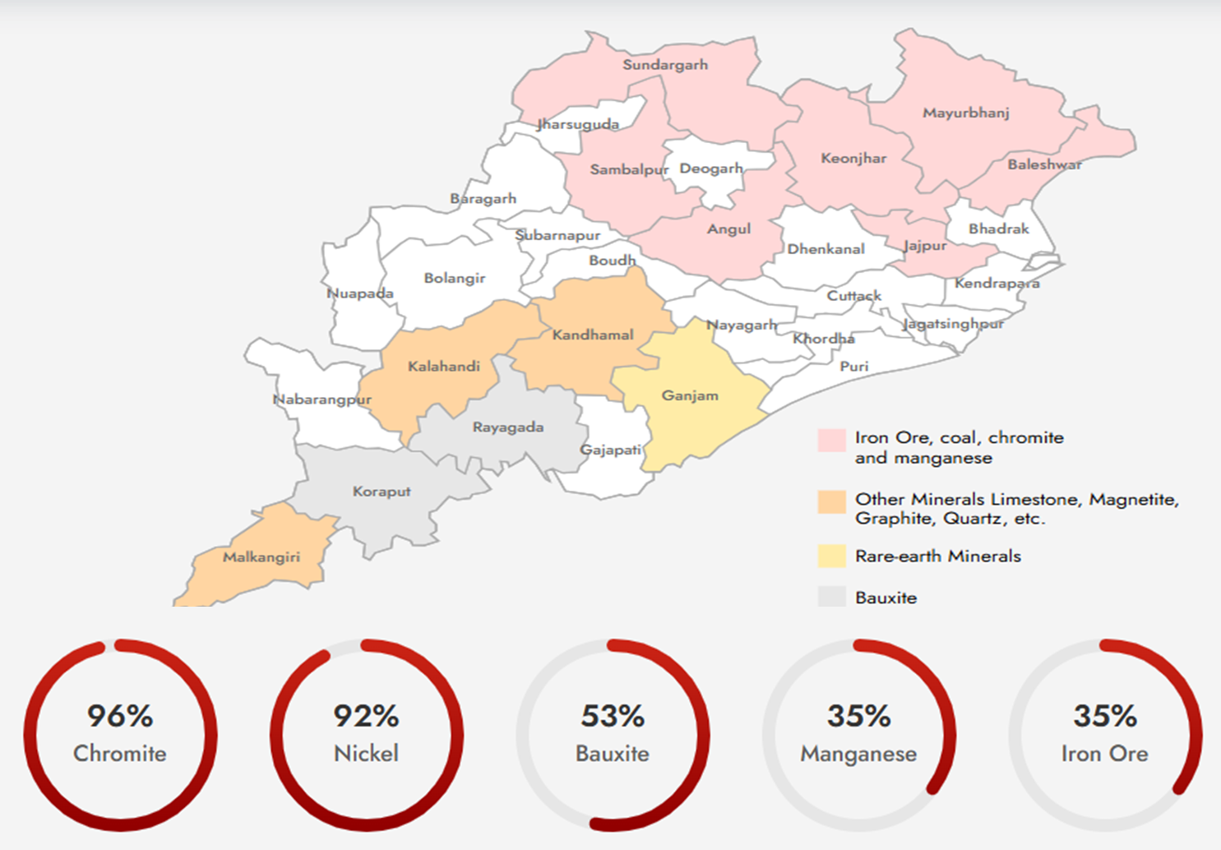
Odisha’s Spread of Mineral Wealth & % National Contribution (20222-23)
Rs 38,075
Crore
Odisha’s Mineral revenue in 2022-23

Slide 41
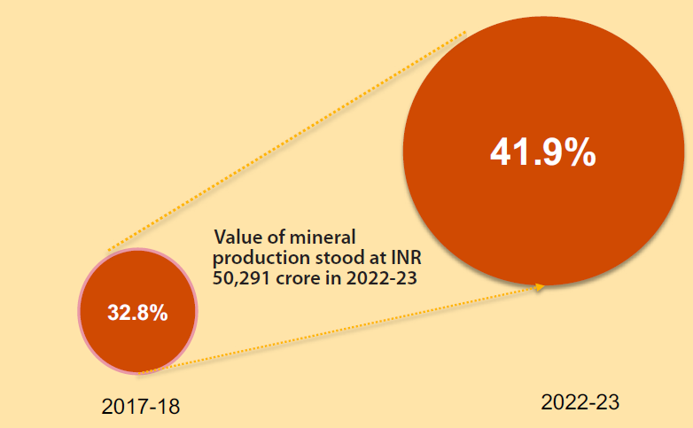
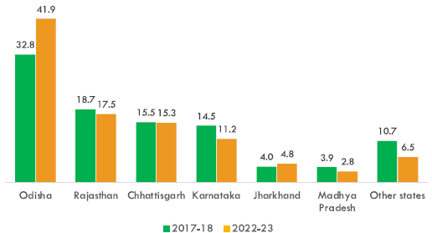
MINERAL PRODUCTION STATS
Odisha, having ~ 30% of Iron Ore reserves in India, stands as the largest Steel and Stainless-Steel producing state of India
Odisha’s share (%) in total value of mineral production in India (100 Crore = 1 Bn)
State-wise comparison of Total Share (%) of mineral production in India
National Value
~ 93,000 Crore
2022-23

Slide 42
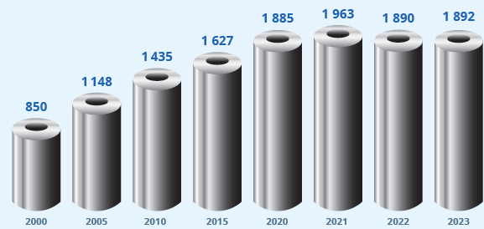
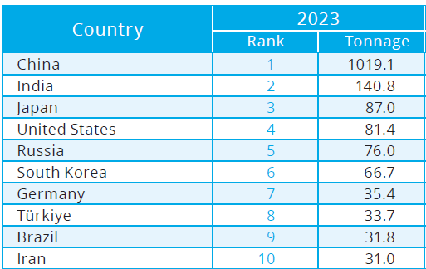
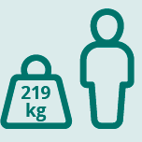
WORLD STEEL OVERVIEW
Global steel production (Mn Tons) 2000 – 2023 (https://worldsteel org/)
Top 10 Steel Producing Nation
Globally, 219 kg of steel was used in new products per person in 2023
But India has only 93 4 Kg ( 43 %) less per Capita Steel Use in 2023

Slide 43
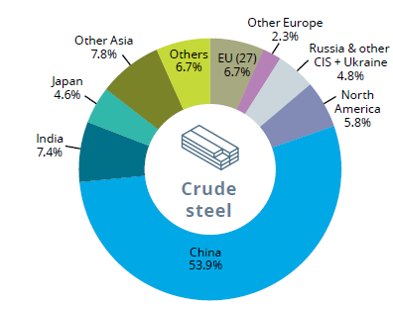
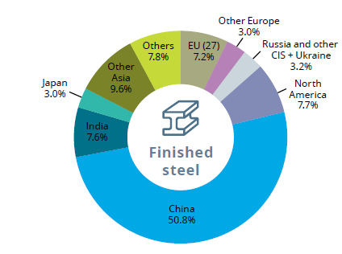
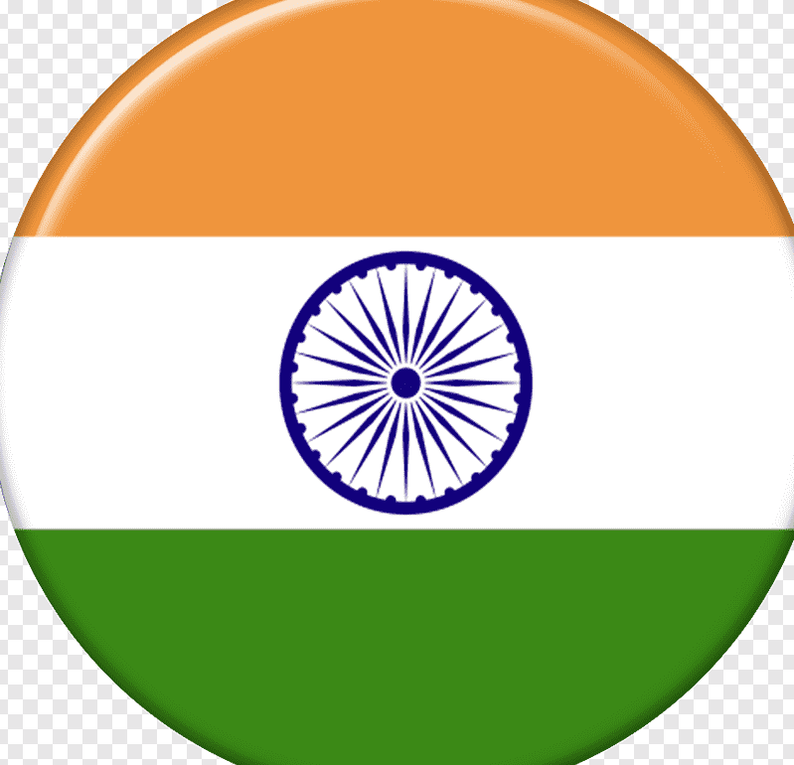
WORLD STEEL OVERVIEW
Top 10 Steel Producing Nation
Geographical Spread of Steel Production- 2023 (https://worldsteel org/)
Geographical Spread of Finished Steel Use - 2023 (https://worldsteel org/)
2nd Largest Producer & Consumer of Steel

Slide 44
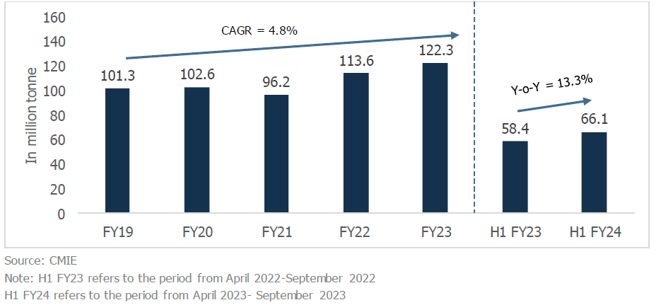
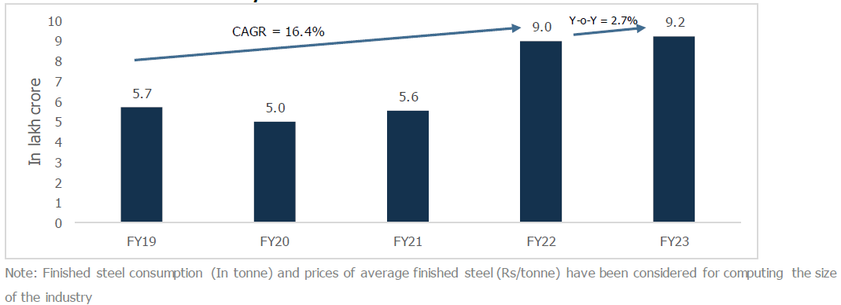
INDIAN STEEL INDUSTRY
YoY Domestic Finished Steel production
YoY Trend of Finished Steel Consumption by Value
India has installed capacity of 161 3 MT in FY23
India has grown steadily with a CAGR of 16 4% from FY19-FY22 in value terms, driven by volume and realisation growth

Slide 45
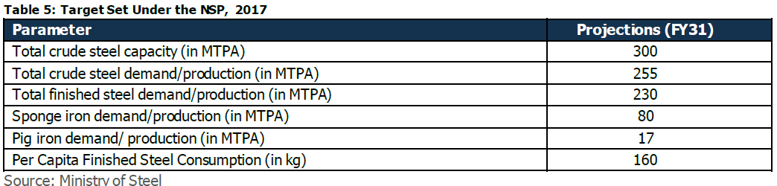

FUTURE FORECASTING & INITIAVES
National Steel Policy
Target
The National Steel Policy envisages achieving 300 MTPA of production capacity from the current level of 153-157 MT to cater to the expected steel demand of 230 MTPA by FY31
The GoI has established an Empowered Group of Secretaries (EGoS) and Project Development Cells (PDCs) to attract and facilitate investments
Specialty steel has been included in the Performance Linked Incentive (PLI) Scheme
Initiatives such as the Steel Scrap Recycling Policy and a roadmap for reducing carbon emissions and promoting green steel have been introduced

Slide 46
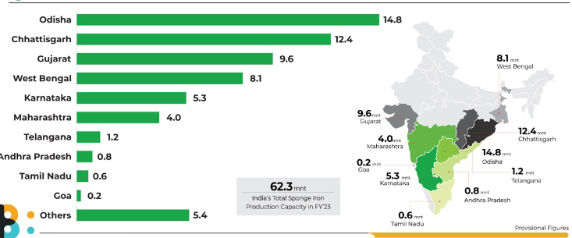
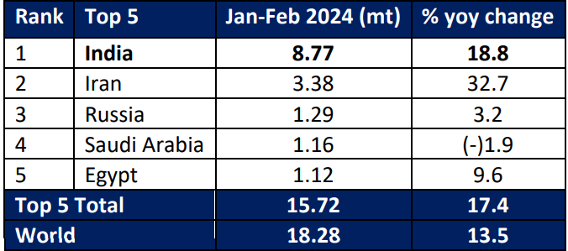
TOP DRI* PRODUCING STATES
World DRI production, Jan-Feb 24 (Million Tons)
India is largest DRI producer, accounting for ~ 48% of the total world production
*Direct Reduced Iron
The state of Odisha is India's largest DRI producer, with ~15 MnTPa ,(FY 23) accounting for 24% of the total production
*

Slide 47
OVERVIEW ODISHA’S METAL SECTOR
2030

Slide 48
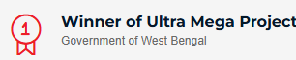
SUCCESS STORIES
Estd – 1966, Kolkata
Prod Mix: Pellets, Sponge iron, Billets, TMT bars, DI Pipes
FY24 Revenue ~ ₹ 30K Crore
EBITDA ~ ₹ 5k Crore ( +52% FY23)

Slide 49
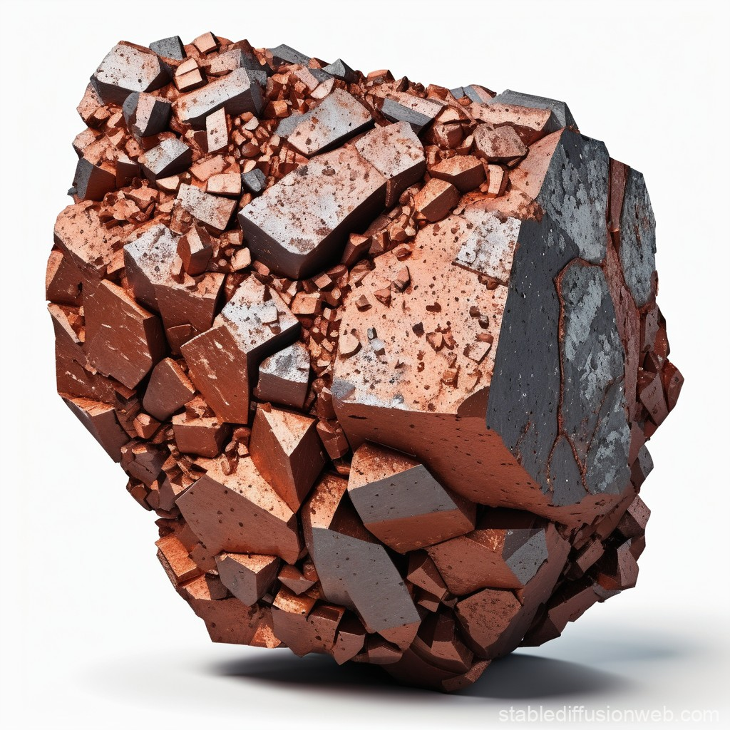
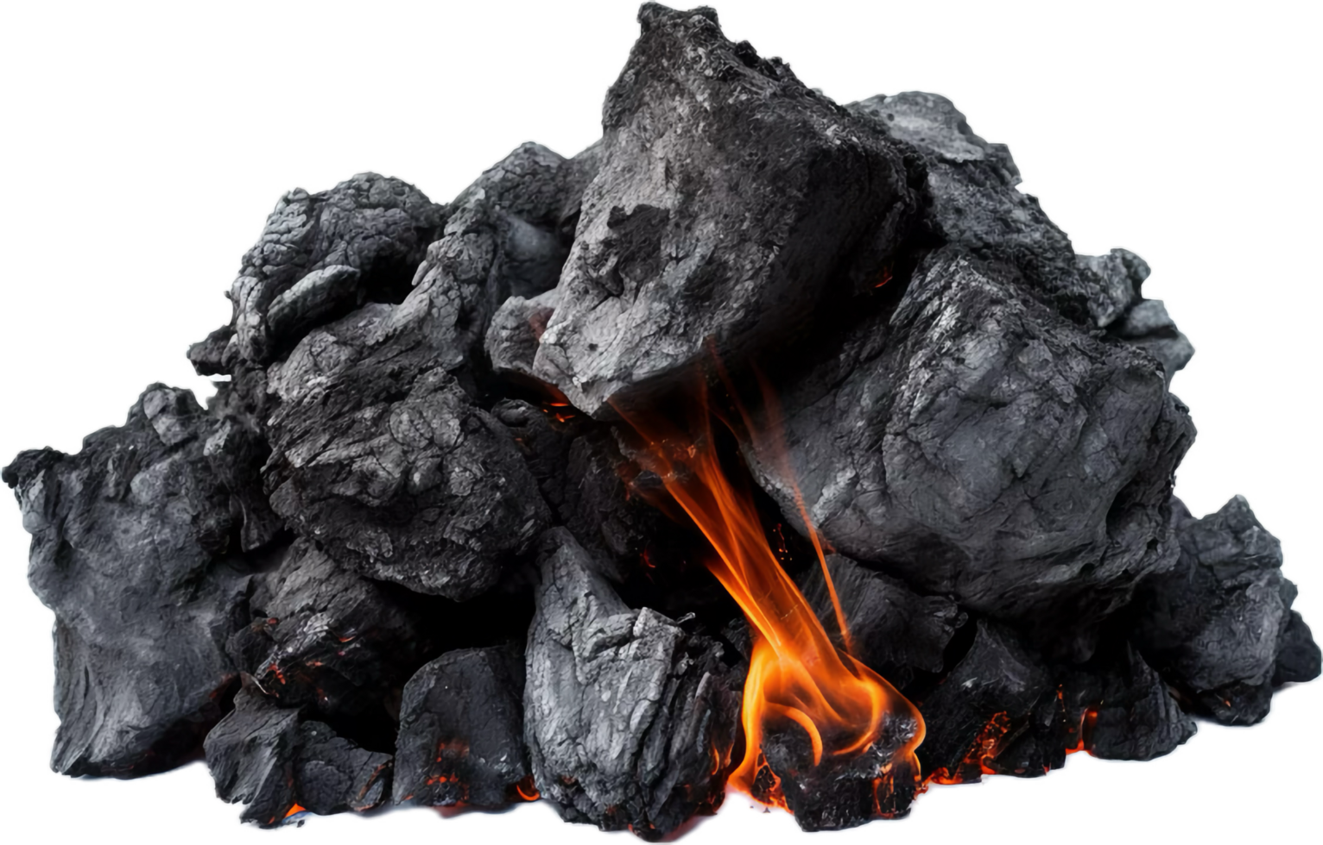
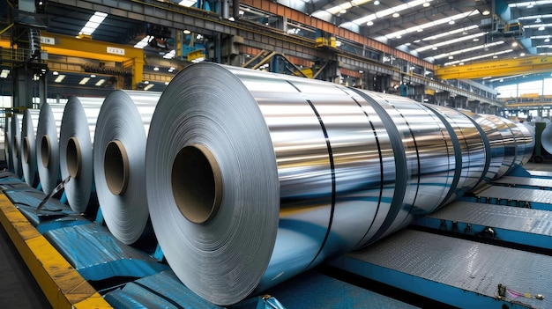
CAPACITY EXPANSION ON BACKWARD INTEGRATION
Backward integrated operations enable steel producers to reduce raw material costs, have better control of the supply chain, and ensure raw material availability
IRON ORE: 1 6-1 7 MT
COKING COAL: 0 6 MT
STEEL : 1 MT
Advantages of Pellet
Through pelletisation, steel manufacturers can utilize iron ore fines available in higher quantities compared to lumps which can be directly utilized in blast furnaces
Pelletisation also reduces transportation costs and handling losses
Pellets have better permeability due to size uniformity and lead to higher plant productivity

Slide 50
Indian Steel Sector Overview
Indian steel sector is the backbone of the country and plays a significant role in India’s economic growth by contributing ~ 2% of India’s GDP
History of India’s modern steel industry dates back to the 19th century with Tata Iron and Steel Company establishing plant in 1907
India has 35286 MMT of Iron Ore reserves which are largely located in Karnataka (30%), Odisha (26%), Chhattisgarh (13%) and Jharkhand (13%)
India is the world’s second-largest producer of crude steel, with an output of 125 32 MT of crude steel and finished steel production of 121 29 MT in FY23
In FY24, the production of crude steel and finished steel stood at 143 6 MT and 138 5 MT, respectively
The Indian Steel Association (ISA) expects steel requirement will reach 128 9 MT in the 2023-24 period, showing an increase from 119 9 MT in the preceding year ​
India’s domestic steel demand is estimated to grow by 9-10% in FY25 as per ICRA
Notes:
ICRA stands for Investment Information and Credit Rating Agency ICRA is an independent agency in India that provides credit ratings and investment information ICRA has provided credit ratings for the steel industry, including the domestic steel industry and the steel sector

Slide 51
Odisha Steel Sector Overview
Odisha is ranked #1 among all states, contributing to 41 9 % (Rs 38,075 Crore) in 2022-23 by value of all Minerals in India Top contributors include Chromite (96%), Nickel (92%), Bauxite (53%) with Manganese & Iron Ore each having 35% share
The state of Odisha is India's largest DRI producer, with ~15 MnTPa (FY 23) accounting for 24% of the total production
Odisha has 52 operational steel plants with installed capacity of around 34 MnTPA as of 2022-23 State has Targeted to achieve > 130 MTPA by 2030
Odisha has signed 49 MoUs with National & International steel companies for establishment of new steel plants apart from Rourkela of SAIL, Kalinga Nagar of NINL and MESCO
The state is strategically located as a gateway to ASEAN region having access to 50% of World Economy in a span of 6 hours
For Ease of doing business, Odisha has numerous facilities:
Capital Investment Subsidy of 20% with no Upper Cap Limit
100% Reimbursement of Net SGST paid (limited to 200%)
3 Major export & import ports
5 Airports
100% reimbursement of ESI / EPF upto 7 Years

Slide 52
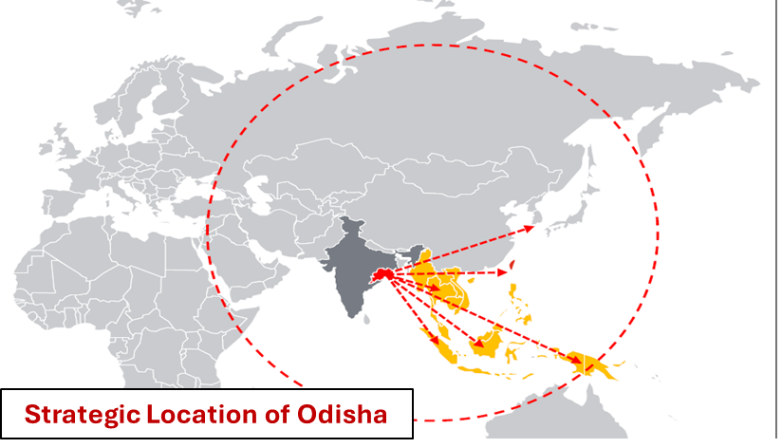
Odisha Steel Sector Overview
Odisha’s Mineral
Map
Odisha is ranked #1 among all states, contributing to 41 9 % (Rs 38,075 Crore) in 2022-23 by value of all Minerals in India Top contributors include Chromite (96%), Nickel (92%), Bauxite (53%) with Manganese & Iron Ore each having 35% share
The state of Odisha is India's largest DRI producer, with ~15 MnTPa (FY 23) accounting for 24% of the total production
Odisha has 52 operational steel plants with installed capacity of around 34 MnTPA as of 2022-23 State has Targeted to achieve > 130 MTPA by 2030
Odisha has signed 49 MoUs with National & International steel companies for establishment of new steel plants apart from Rourkela of SAIL, Kalinga Nagar of NINL and MESCO
The state is strategically located as a gateway to ASEAN region having access to 50% of World Economy in a span of 6 hours
For Ease of doing business, Odisha has numerous facilities:
Capital Investment Subsidy of 20% with no Upper Cap Limit
100% Reimbursement of Net SGST paid (limited to 200%)
3 Major export & import ports
5 Airports
100% reimbursement of ESI / EPF upto 7 Years

Slide 53
Indian Steel Sector Overview
India is the second-largest steel producer in the world with an installed capacity of 161 3 MT in FY23 and consumption of 126 MT in FY2023
The domestic crude steel production has grown at a CAGR of 3 3% in the past five years to reach 126 3 MT in FY23 from 110 9 MT in FY19 and this growth is due to increased domestic demand, availability of raw materials, cost effective labour etc
Large steel manufacturers’ capacity utilization has been in the range of 80-90% in FY23 and most players have announced the expansion of crude steel capacities
The National Steel Policy 2017 envisages achieving 300 MT by 2030 of production capacity from the current level of 153-157 MT to cater to expected steel demand of 230 MT by FY31
State wise National Share (%-Value) of Minerals
India’s eastern region, well-endowed with mineral resources, enjoys the largest share in the total crude steel-making capacity (55%) and is led by Odisha having more than 30 MMT crude steel capacities
Odisha is rich in iron ore reserves having more than 26% reserves and abundant ancillary factors such as coal, water etc making Odisha preferred location for steel production

Slide 54
HIGHLAND MARINE DIVISION
EXPORT TO VARIOUS COUNTRIES
ANNUAL TURNOVER [IN CR ]

Slide 55
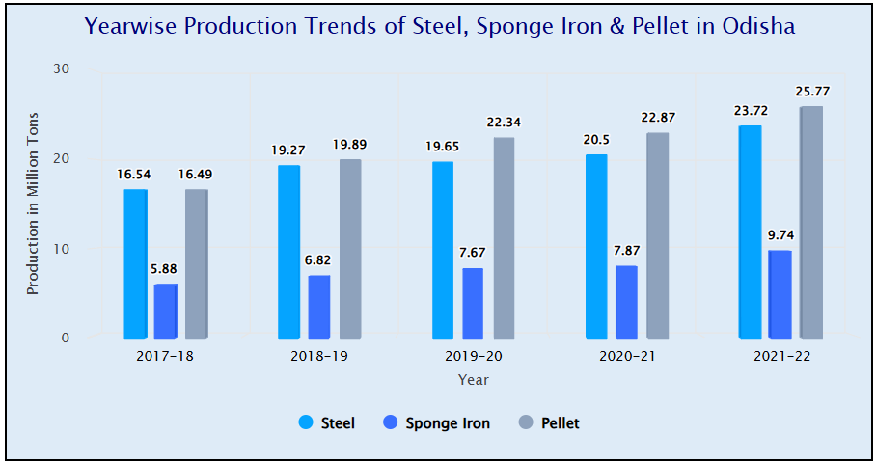
STATE STATISTICS OF STEEL
Odisha has 52 operational steel plants with installed capacity of around 35 MTPA as of 2022-23
State has Targeted to achieve > 130 MTPA by 2030
Production Trends of Steel, Sponge Iron & Pellet in Odisha in Million Tons Per Annum (MTPA)

Slide 56
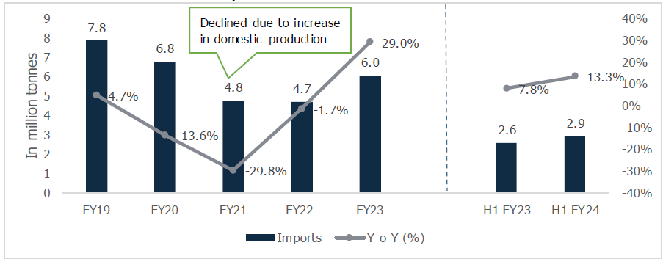
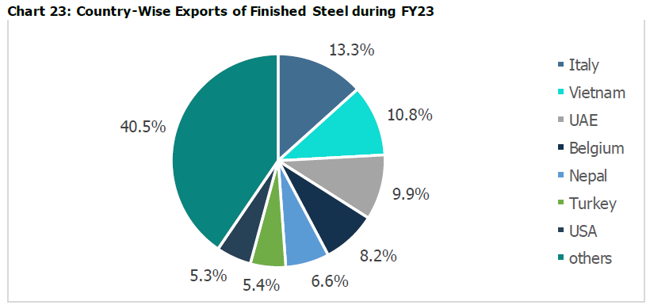
EX-IM INDIA STATISTICS
Import Figures 2023 & Forecast
Country wise Export FY 2023
The finished steel imports declined from 7 8 MnT in FY19 to 4 7 MT in FY22 This is accredited to a healthy increase in domestic supply
During FY23, India’s finished steel imports grew by 29% y-o-y to 6 MnT due to the rise in low-cost imports from Russia
In H1 FY24, the finished steel imports have increased by 13 3% y-o-y to 2 9 MnT

Slide 57
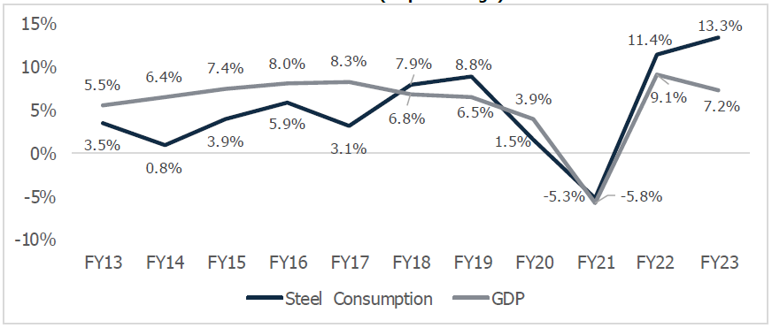
STEEL DEMAND GROWTH AND GDP GROWTH
The steel demand in India is closely correlated to GDP growth as expansion in GDP leads to healthy growth in the construction manufacturing & demand of basic Amenities
India is expected to grow at 6 3% in CY24 compared to the world real GDP growth projection of 3%

Slide 58

FUTURE FORECASTING & INITIAVES
India’s steel consumption to see healthy growth of 9-11% y-o-y in FY24 By FY26, the steel consumption is expected to reach between 151-155 MT, indicating a CAGR of 7-8% between FY24 and FY26
It will be driven by sectors like construction, real estate, railways, roads, capital goods, and consumer durables, among others, in addition to government expenditure on infrastructure

Slide 59

New Opportunities

Slide 60

Infrastructure Preparedness

